Slide 1


Marco Ramos
2024-05-24

Slide 2

Outline
Executive Summary
Introduction
Methodology
Results
Conclusion
Appendix

Slide 3
Executive Summary
Methodologies used in this project
Data collection, using web scrapping and SpaceX API;
Exploratory data analysis, using static and dynamic/interactive data visualizations;
Feature engineering, on selected features to process categorical variables;
Predictive analysis, building and testing different classification machine learning models;
Summary of all results
From all the features collected, the best were selected to be used for machine learning, which include Flight Number, Payload Mass, Flights, Block, Reused Count, Orbit, Launch Site, Landing Pad, Serial, Grid Fins, Reused, Reused, Legs;
After testing and tunning a decision tree classifier model was selected due to presenting the higher accuracy of the tested models;
Its possible to predict the success of a booster landing with the features available;

Slide 4
Introduction
A new rocket Company Space Y, founded by Billionaire industrialist Allon Musk would like to compete with SpaceX.
The main problem is predicting the cost of each launch and so, some questions were defined:
Can we determine if the first stage/booster will perform a successful landing?
Where is the best place to make launches?

Slide 5

Section 1

Slide 6
Methodology
Executive Summary
Data collection methodology:
Data from SpaceX was obtained from 2 sources:
SpaceX public API;
Web scrapping Wikipedia page about Falcon Rocket launches:
Perform data wrangling
Data after collection as analyzed and cleaned/formated by filtering unwanted launches related to old booster versions.
Perform exploratory data analysis (EDA) using visualization and SQL
Perform interactive visual analytics using Folium and Plotly Dash
Perform predictive analysis using classification models
How to build, tune, evaluate classification models

Slide 7
Data Collection
Describe how data sets were collected.
You need to present your data collection process use key phrases and flowcharts

Slide 8
Data Collection – SpaceX API
Present your data collection with SpaceX REST calls using key phrases and flowcharts
Add the GitHub URL of the completed SpaceX API calls notebook (must include completed code cell and outcome cell), as an external reference and peer-review purpose
Place your flowchart of SpaceX API calls here

Slide 9
Data Collection - Scraping
Present your web scraping process using key phrases and flowcharts
Add the GitHub URL of the completed web scraping notebook, as an external reference and peer-review purpose
Place your flowchart of web scraping here

Slide 10
Data Wrangling
Describe how data were processed
You need to present your data wrangling process using key phrases and flowcharts
Add the GitHub URL of your completed data wrangling related notebooks, as an external reference and peer-review purpose

Slide 11
EDA with Data Visualization
Summarize what charts were plotted and why you used those charts
Add the GitHub URL of your completed EDA with data visualization notebook, as an external reference and peer-review purpose

Slide 12
EDA with SQL
Using bullet point format, summarize the SQL queries you performed
Add the GitHub URL of your completed EDA with SQL notebook, as an external reference and peer-review purpose

Slide 13
Build an Interactive Map with Folium
Summarize what map objects such as markers, circles, lines, etc. you created and added to a folium map
Explain why you added those objects
Add the GitHub URL of your completed interactive map with Folium map, as an external reference and peer-review purpose

Slide 14
Build a Dashboard with Plotly Dash
Summarize what plots/graphs and interactions you have added to a dashboard
Explain why you added those plots and interactions
Add the GitHub URL of your completed Plotly Dash lab, as an external reference and peer-review purpose

Slide 15
Predictive Analysis (Classification)
Summarize how you built, evaluated, improved, and found the best performing classification model
You need present your model development process using key phrases and flowchart
Add the GitHub URL of your completed predictive analysis lab, as an external reference and peer-review purpose

Slide 16
Results
Exploratory data analysis results
Interactive analytics demo in screenshots
Predictive analysis results

Slide 17

Section 2

Slide 18
Flight Number vs. Launch Site
Show a scatter plot of Flight Number vs. Launch Site
Show the screenshot of the scatter plot with explanations

Slide 19
Payload vs. Launch Site
Show a scatter plot of Payload vs. Launch Site
Show the screenshot of the scatter plot with explanations

Slide 20
Success Rate vs. Orbit Type
Show a bar chart for the success rate of each orbit type
Show the screenshot of the scatter plot with explanations

Slide 21
Flight Number vs. Orbit Type
Show a scatter point of Flight number vs. Orbit type
Show the screenshot of the scatter plot with explanations

Slide 22
Payload vs. Orbit Type
Show a scatter point of payload vs. orbit type
Show the screenshot of the scatter plot with explanations

Slide 23
Launch Success Yearly Trend
Show a line chart of yearly average success rate
Show the screenshot of the scatter plot with explanations

Slide 24
All Launch Site Names
Find the names of the unique launch sites
Present your query result with a short explanation here

Slide 25
Launch Site Names Begin with 'CCA'
Find 5 records where launch sites begin with `CCA`
Present your query result with a short explanation here

Slide 26
Total Payload Mass
Calculate the total payload carried by boosters from NASA
Present your query result with a short explanation here

Slide 27
Average Payload Mass by F9 v1.1
Calculate the average payload mass carried by booster version F9 v1.1
Present your query result with a short explanation here

Slide 28
First Successful Ground Landing Date
Find the dates of the first successful landing outcome on ground pad
Present your query result with a short explanation here

Slide 29
Successful Drone Ship Landing with Payload between 4000 and 6000
List the names of boosters which have successfully landed on drone ship and had payload mass greater than 4000 but less than 6000
Present your query result with a short explanation here

Slide 30
Total Number of Successful and Failure Mission Outcomes
Calculate the total number of successful and failure mission outcomes
Present your query result with a short explanation here

Slide 31
Boosters Carried Maximum Payload
List the names of the booster which have carried the maximum payload mass
Present your query result with a short explanation here

Slide 32
2015 Launch Records
List the failed landing_outcomes in drone ship, their booster versions, and launch site names for in year 2015
Present your query result with a short explanation here

Slide 33
Rank Landing Outcomes Between 2010-06-04 and 2017-03-20
Rank the count of landing outcomes (such as Failure (drone ship) or Success (ground pad)) between the date 2010-06-04 and 2017-03-20, in descending order
Present your query result with a short explanation here

Slide 34

Section 3

Slide 35
<Folium Map Screenshot 1>
Replace <Folium map screenshot 1> title with an appropriate title
Explore the generated folium map and make a proper screenshot to include all launch sites’ location markers on a global map
Explain the important elements and findings on the screenshot

Slide 36
<Folium Map Screenshot 2>
Replace <Folium map screenshot 2> title with an appropriate title
Explore the folium map and make a proper screenshot to show the color-labeled launch outcomes on the map
Explain the important elements and findings on the screenshot

Slide 37
<Folium Map Screenshot 3>
Replace <Folium map screenshot 3> title with an appropriate title
Explore the generated folium map and show the screenshot of a selected launch site to its proximities such as railway, highway, coastline, with distance calculated and displayed
Explain the important elements and findings on the screenshot

Slide 38

Section 4

Slide 39
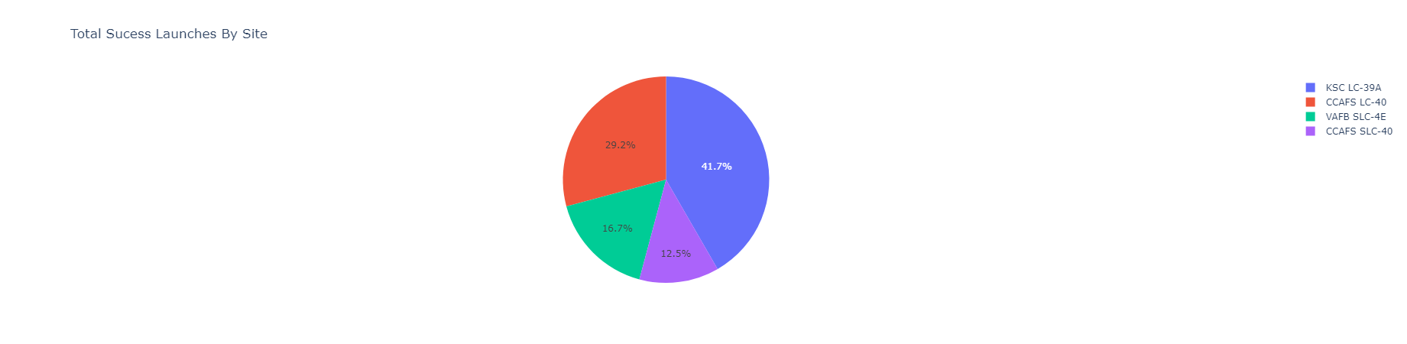
Successful Launches by Site
The launch site with the most success launches is KSC LC-39A with 41.7% of all the successful launches.

Slide 40
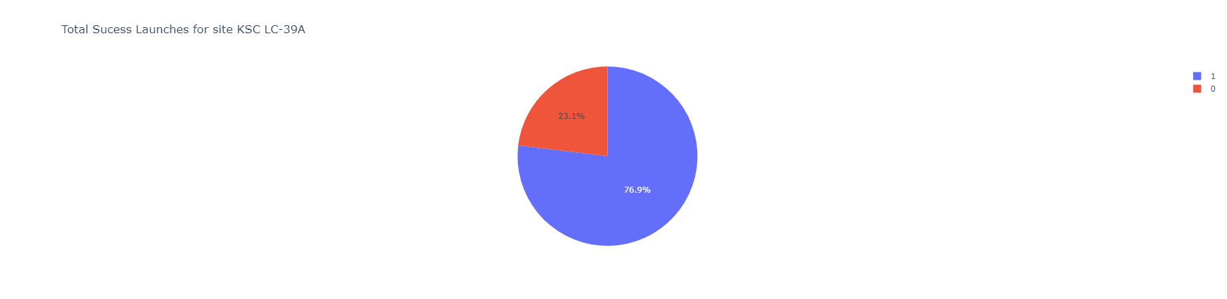
Launch Success Ratio for KSC-39A
The site KSC LC-39A has a launch success ratio of 76.9%;

Slide 41
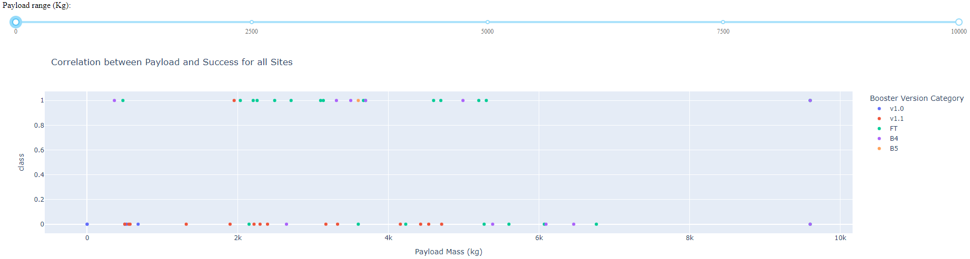
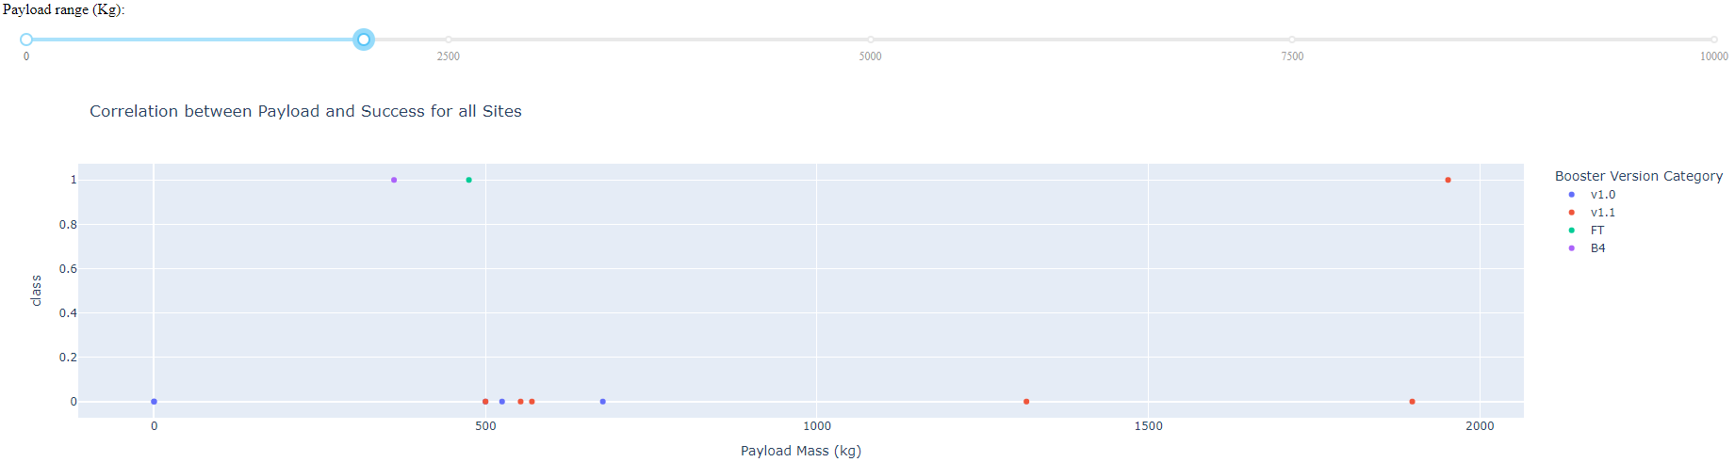
Payload vs. Launch Outcome vs. Booster Version
Versions v1.0 and v1.1 have low payload launches and success ratio;
For booster version B5, only have one point with a successful launch;
With lower payload mass, more recent booster versions and a high success ratio;

Slide 42
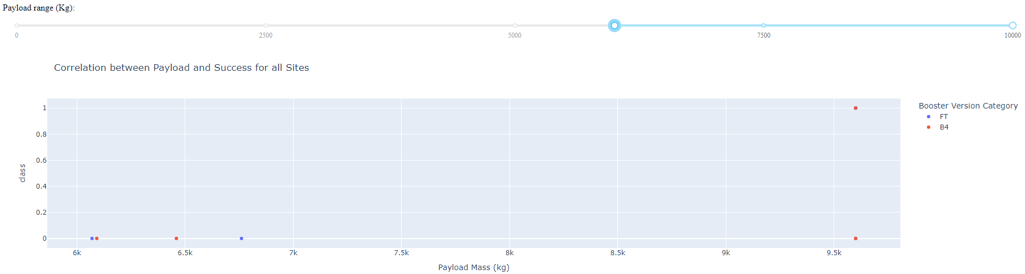
Payload vs. Launch Outcome vs. Booster Version
Both FT and B4 had a success and fail launch with payload higher than 7000kg making impossible with only these two variables make proper predictions to high mass payloads;

Slide 43

Section 5

Slide 44
Classification Accuracy
Visualize the built model accuracy for all built classification models, in a bar chart
Find which model has the highest classification accuracy

Slide 45
Confusion Matrix
Show the confusion matrix of the best performing model with an explanation

Slide 46
Conclusions
Point 1
Point 2
Point 3
Point 4
…

Slide 47
Appendix
Include any relevant assets like Python code snippets, SQL queries, charts, Notebook outputs, or data sets that you may have created during this project

Slide 48


